Slide 1


DBMS PROJECT-BASED LEARNING · PROJECT 02
Review 2 — Normalization, SQL DDL & Prototype
Library Circulation & Digital Resource Management System
3NF Schema Design · MySQL Integrity Constraints · Operational SQL Queries · LibraryOS Prototype
Himesh Sarvan S | 25WU0102099 | B.Tech AIML

Slide 2

Agenda
01 · 3NF Normalization
02 · Final Relational Schema
03 · SQL DDL Scripts
04 · Business Rules
Functional dependencies across 11 core tables.
Primary keys, foreign keys, unique constraints.
Enforcing domain rules on Books, Copies, Issues.
Max 3 loans, 14-day window, ₹2/day overdue fine.
05 · Seed Data Population
06 · Operational SQL Joins
07 · Prototype Architecture
08 · Progress & Roadmap
10 titles, 26 physical copies, 5 member accounts.
Multi-table joins for availability and overdues.
Interactive LibraryOS SPA UI and Flask API routes.
Week 11 milestone status and Review 3 targets.

Slide 3
Schema Refinement & 3NF Normalization
1NF — ATOMIC DOMAINS
2NF — FULL DEPENDENCY
3NF — ZERO TRANSITIVE LINKS
Title vs. Physical Copy
Circulation Decoupling
Role & Lookup Isolation
Separated book metadata (ISBN, title) from physical barcoded units (accession_no in copies).
issues, reservations, and fines depend solely on surrogate keys (issue_id, reservation_id).
Extracted members profile attributes from users; isolated categories and publishers.

Slide 4
Normalized 3NF Relational Schema
Table Name | Primary Key | Foreign Keys & Domain Constraints
users / members | user_id | email UNIQUE, member_code UNIQUE, wallet_balance DEFAULT 1000
categories / publishers | category_id / publisher_id | Referenced by books; stores subject icons and publisher cities
books | book_id | isbn UNIQUE; FK → category_id, publisher_id
copies | copy_id | accession_no UNIQUE; FK → book_id; status IN (available, issued, reserved)
issues | issue_id | FK → copy_id, book_id, member_id; due_date > issue_date
reservations | reservation_id | FK → book_id, member_id, copy_id; tracks queue_position
fines | fine_id | FK → issue_id, member_id; CHECK (amount >= 0)
digital_resources / logs | resource_id / log_id | FK → resource_id, member_id; timestamps member e-resource access

Slide 5
SQL DDL & Integrity Constraints
CREATE TABLE copies ( copy_id INT AUTO_INCREMENT PRIMARY KEY, book_id INT NOT NULL, accession_no VARCHAR(30) UNIQUE NOT NULL, status ENUM('available','issued','reserved') DEFAULT 'available', FOREIGN KEY (book_id) REFERENCES books(book_id) ); CREATE TABLE issues ( issue_id INT AUTO_INCREMENT PRIMARY KEY, copy_id INT NOT NULL, member_id INT NOT NULL, issue_date DATE NOT NULL, due_date DATE NOT NULL, status ENUM('active','overdue','returned') DEFAULT 'active', CONSTRAINT chk_dates CHECK (due_date > issue_date) );
Accession Uniqueness
CREATE TABLE copies ( copy_id INT AUTO_INCREMENT PRIMARY KEY, book_id INT NOT NULL, accession_no VARCHAR(30) UNIQUE NOT NULL, status ENUM('available','issued','reserved') DEFAULT 'available', FOREIGN KEY (book_id) REFERENCES books(book_id) ); CREATE TABLE issues ( issue_id INT AUTO_INCREMENT PRIMARY KEY, copy_id INT NOT NULL, member_id INT NOT NULL, issue_date DATE NOT NULL, due_date DATE NOT NULL, status ENUM('active','overdue','returned') DEFAULT 'active', CONSTRAINT chk_dates CHECK (due_date > issue_date) );
Barcoded physical copies prevented from duplication via UNIQUE index.
Deletion Protection
Foreign keys block deleting books with active issues or reservations.
Domain Validation
Strict state transitions enforced via ENUM and date CHECK constraints.

Slide 6
Enforced Circulation Business Rules
3 Books
14 Days
₹2 / Day
₹1,000
Max Active Loans / Member
Default Borrowing Window
Automated Overdue Fine
Starting Member Wallet
All rules are validated both in the frontend SPA and at the Python Flask / MySQL transaction level.

Slide 7
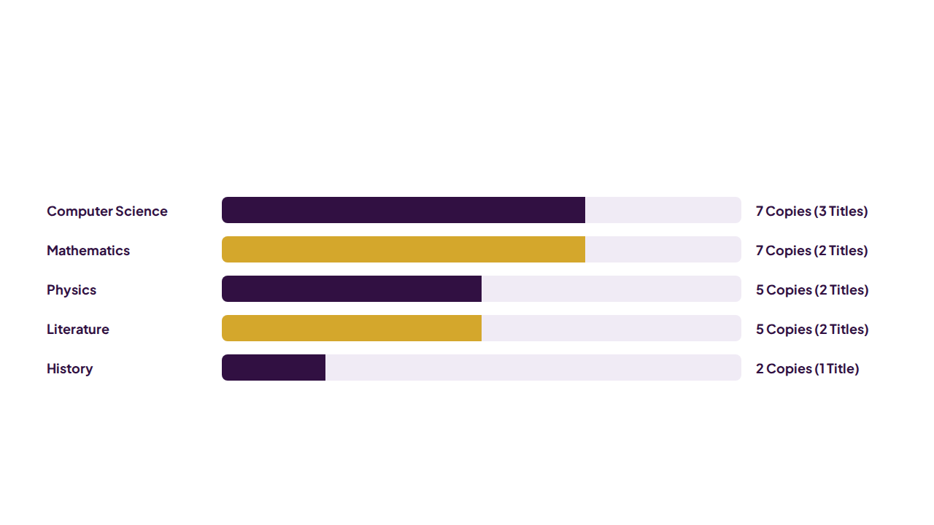
Database Seed Population (26 Copies Across 10 Titles)

Slide 8
Operational SQL Queries — Joins & Views
SELECT b.book_id, b.title, c.category_name, COUNT(CASE WHEN cp.status='available' THEN 1 END) AS available_copies, COUNT(cp.copy_id) AS total_copies FROM books b LEFT JOIN categories c ON b.category_id=c.category_id LEFT JOIN copies cp ON b.book_id=cp.book_id GROUP BY b.book_id ORDER BY b.title;
1. Real-Time Copy Availability Join
SELECT i.issue_id, b.title, u.full_name, DATEDIFF(CURDATE(), i.due_date) AS days_late, DATEDIFF(CURDATE(), i.due_date) * 2 AS fine_est FROM issues i JOIN books b ON i.book_id = b.book_id JOIN users u ON i.member_id = u.user_id WHERE i.status = 'overdue' ORDER BY days_late DESC;
2. Dynamic Overdue & Fine Estimation
SELECT b.book_id, b.title, c.category_name, COUNT(CASE WHEN cp.status='available' THEN 1 END) AS available_copies, COUNT(cp.copy_id) AS total_copies FROM books b LEFT JOIN categories c ON b.category_id=c.category_id LEFT JOIN copies cp ON b.book_id=cp.book_id GROUP BY b.book_id ORDER BY b.title;
SELECT i.issue_id, b.title, u.full_name, DATEDIFF(CURDATE(), i.due_date) AS days_late, DATEDIFF(CURDATE(), i.due_date) * 2 AS fine_est FROM issues i JOIN books b ON i.book_id = b.book_id JOIN users u ON i.member_id = u.user_id WHERE i.status = 'overdue' ORDER BY days_late DESC;

Slide 9
Automated Reservation Queue Fulfillment
1
2
3
4
Return Logged
Queue Polled
Copy Locked
Ready Alert
Issue marked returned; copy freed.
Finds lowest queue_position for book.
Copy status updated to reserved.
Member reservation set to ready.

Slide 10
Working Prototype — LibraryOS Dual Portal
Librarian / Admin Portal (8 Views)
Student / Member Portal (7 Views)
Live KPI Dashboard: 8 real-time counters & activity feed.
Hero Catalogue Search: Filter by subject icon, title, or ISBN.
Catalogue & Copy Manager: Add ISBNs and barcoded copies.
Queue Reservation: Instant reserve or waitlist placement.
Digital Library Hub: Logs access to IEEE, JSTOR, SpringerLink.
Issue & Return Desk: Real-time overdue fine preview box.
Reservation & Fine Control: 1-click queue issue & fee collection.
Personal Loans & Fines: Track due dates and outstanding dues.

Slide 11
Project Planning — Timeline (Week 11 Status)
Wk 3
Wk 7
Wk 11 — YOU ARE HERE
Wk 14
Wk 16
Assessments Begin
Review 1 (Completed)
Review 2: 3NF, DDL & Prototype
Assessments Conclude
Review 3 + MOOC Final
Milestone Progress: Normalized 3NF schema, MySQL DDL scripts, operational join queries, and interactive LibraryOS UI prototype completed on schedule.

Slide 12
Summary & Next Steps
Covered in Review 2
Coming in Review 3 (Final)
3NF Normalization: Eliminated partial & transitive dependencies.
Full-Stack Flask API: 25+ REST endpoints with MySQL transactions.
SQL DDL Scripts: Enforced PK, FK, UNIQUE, and CHECK rules.
Digital Wallet Settlement: Instant fine payment with SQL rollback.
Sample Data & Queries: 26 copies populated with live SQL joins.
4-Tab Analytics Suite: Overdues, popular books, fines, access logs.
Working Prototype: LibraryOS SPA with Admin & Member portals.
Indexing & Validation: Systematic testing and final deployment.

Slide 13


Thank You
Review 2 — Library Circulation & Digital Resource Management System
Himesh Sarvan S · 25WU0102099 · B.Tech AIML
Questions & Prototype Demonstration

